Slide 1
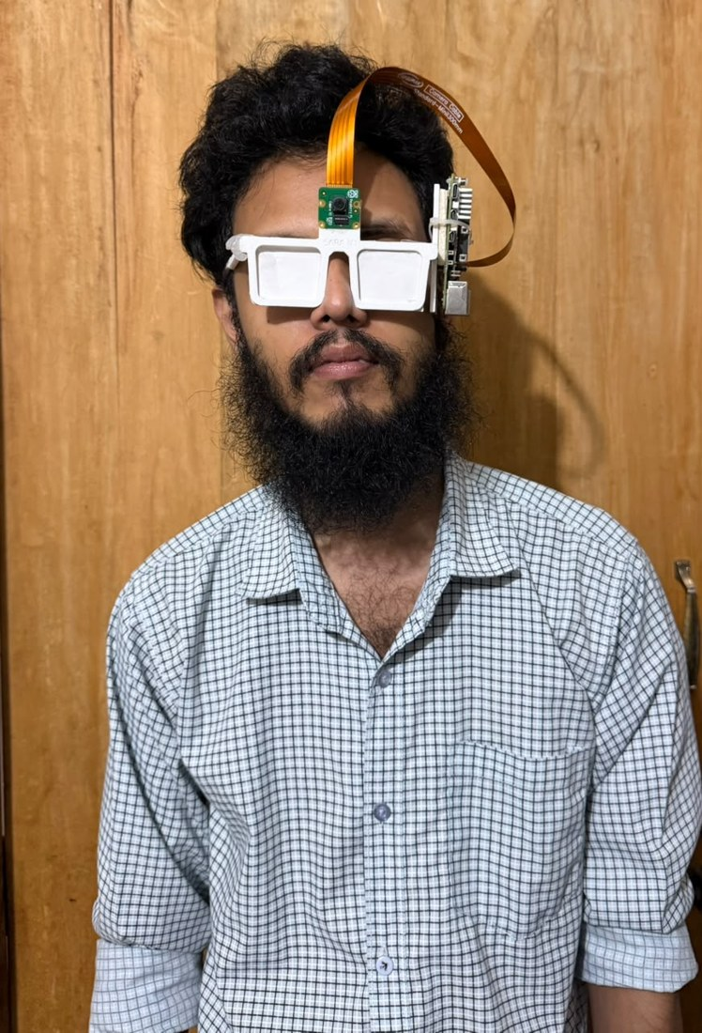
Savior Glass
An offline, Bangla-first assistive smart glass for visually impaired people
MD Abdun Fattah Lam (2220014) · Mukut Protim Memo (2020086) · Tanjila Hossain Tapti (2130561)
Supervisor: Mohammad Shidujaman, PhD, Assistant Professor
Department of Computer Science and Engineering, Independent University, Bangladesh · Spring 2026
Notes:
Good morning. We are presenting Savior Glass, a smart glass for blind and low-vision people in Bangladesh. It reads Bangla and English text, names objects, recognises Taka notes and gives careful advice about counterfeit notes, and it does this on the device without the internet. The photo shows our first prototype being worn.

Slide 2



Reading, recognising and paying still need a helper
A blind person buys medicine and receives change. To know what the label says, which note came back and whether it is real, they must ask someone, and they cannot check the answer.
Built for English
Existing devices do not read Bangla or know Taka notes.
Need internet or money
2.2 billion
Many send pictures to a server or need a phone and a paid service.
people live with some form of vision impairment (WHO)
Answers cannot be checked
A wrong note or a false "counterfeit" costs money or causes an accusation.
Notes:
The problem in one sentence: there is no affordable wearable device that reads Bangla, recognises Taka and gives trustworthy advice about counterfeit notes without a phone or the internet. Three things make it hard: language, connectivity and cost, and trust, because a blind user cannot check what the device says.

Slide 3
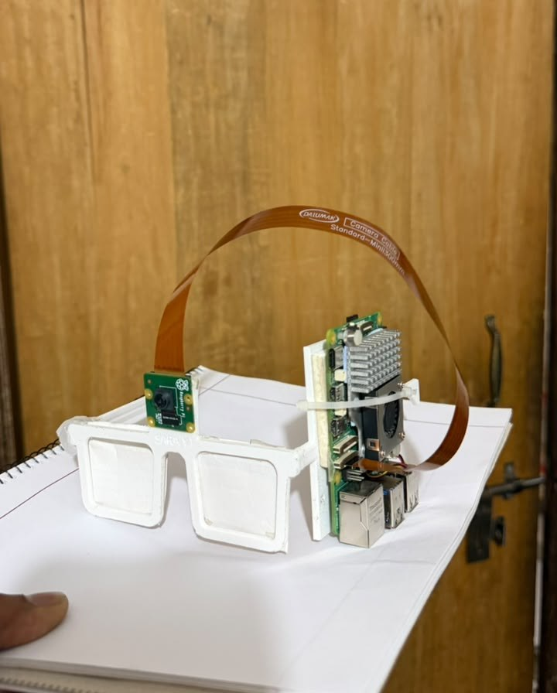





Savior Glass: five modes, five buttons, Bangla speech
Text reading
Objects
Bangla and English OCR, spoken right after capture
Names objects in front of the user every 1.5 s
Currency
Emotion
All nine Taka notes, with a cautious counterfeit check
Facial expression of the person in front
Online description
Controlled by MODE, ACTION, READ and two volume buttons. Every change is spoken.
Optional; the only mode that needs the internet
Notes:
This is our solution. A camera sits above the bridge of a 3D-printed frame and a Raspberry Pi 5 runs everything. The user cycles five modes with one button and presses ACTION to capture. Only the online mode needs the internet; the other four run on the device.

Slide 4
Six research questions
1
System
2
Synthetic data
Can a multi-function Bangla glass run on a Raspberry Pi 5, and how fast?
Can a Taka detector trained without hand labels work on real photographs?
3
Number of views
4
Unseen prints
Why do multi-view counterfeit models fail with fewer views, and can training fix it?
How much does accuracy drop on counterfeit prints never seen in training?
5
Safety
6
Bangla OCR
Can the glass give counterfeit advice that never accuses a genuine note?
Which part of a Bangla OCR pipeline matters most for a wearable camera?
Notes:
These six questions organise the rest of the talk: the system on the Pi, synthetic training data for currency, the number of views, unseen counterfeit prints, a safe spoken verdict, and Bangla OCR.

Slide 5
What existing devices miss
System | Reads Bangla | Knows Taka | Works offline | Wearable
OrCam MyEye | No | No | Yes | Yes
Google Glass scene analysis | No | No | No | Yes
AIris (2024) | No | No | No | Yes
Raspberry Pi reading aids | No | No | Partly | Partly
Savior Glass (ours) | Yes | Yes | Yes | Yes
The gap
No device combines Bangla, Taka and offline use. Counterfeit studies never check whether test notes are copies of prints seen in training.
Online: the online description mode needs the internet; the other four modes do not.
Notes:
Commercial glasses such as OrCam work offline but not in Bangla and not with Taka. Glass-based research systems send pictures to a server. Raspberry Pi reading aids are cheap but mostly English and use online speech. The second gap is in evaluation, which we come back to in the counterfeit part.

Slide 6



How the glass works
Text: EasyOCR + main-block rule
Raspberry Pi 5
mode manager
Objects: YOLOv8
Camera
640×480
Currency: YOLOv8s + safe check
Bangla / English speech
+ vibration
Emotion: YuNet + EfficientNet
5 buttons
Online: vision model (optional)
All models run on the Pi's CPU. Every event is written to a small CSV field log for later study.
Notes:
The camera frame and the button presses go to a mode manager on the Raspberry Pi. The active mode runs its model, and the result is spoken in Bangla or English, with a vibration for a detected note. The heavy work runs only when the user presses ACTION, except the object scan.

Slide 7
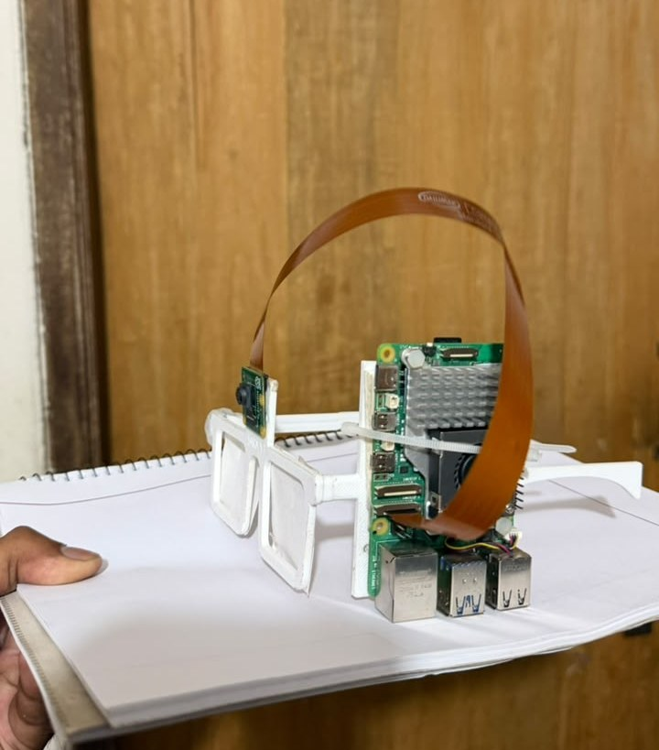
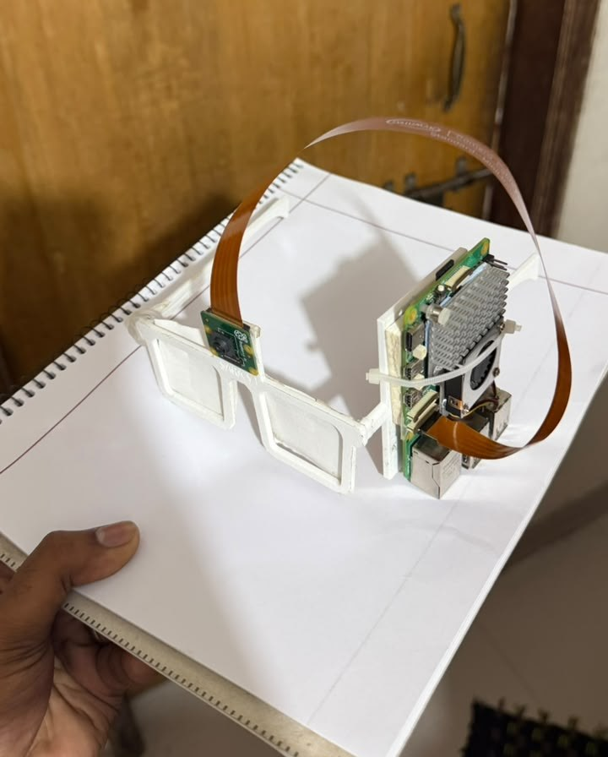
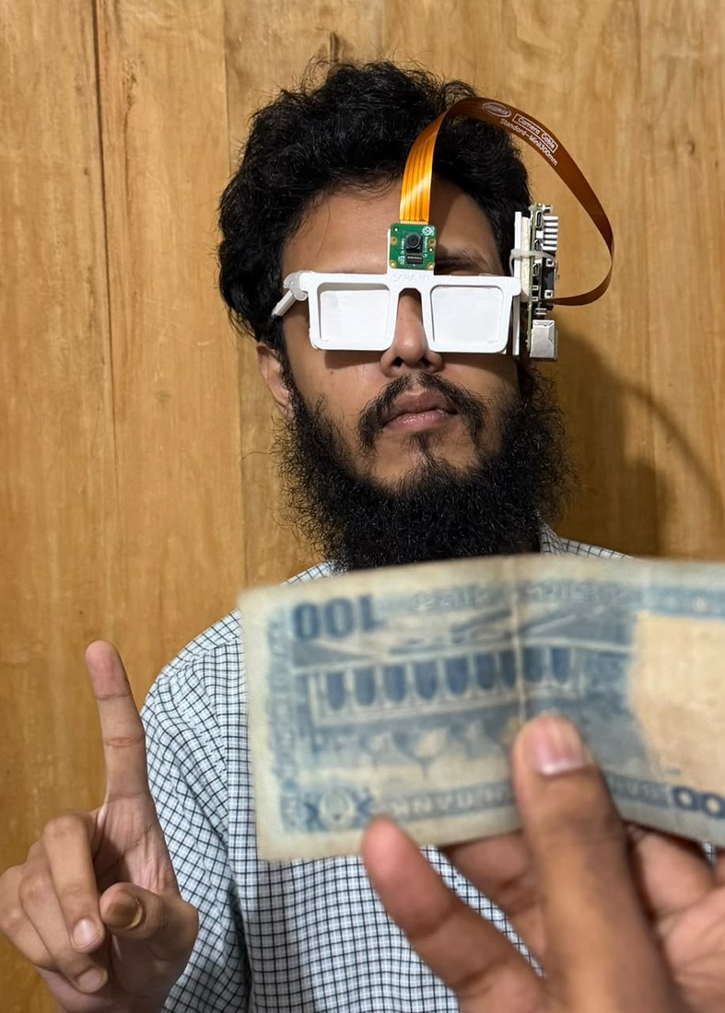
From design to a first prototype
Camera above the bridge of a 3D-printed frame
Raspberry Pi 5 with fan tied to the right temple
Ribbon cable loops from camera to board
Next: board, buttons and battery in a pocket enclosure
The first prototype is heavy on one side and the fan sits by the ear. It is enough to test the software on a person.
Notes:
This is the first prototype. It was the quickest way to get a working device on a person's head. It also shows why the design calls for a separate pocket enclosure: the board on one temple makes it heavy on one side.

Slide 8
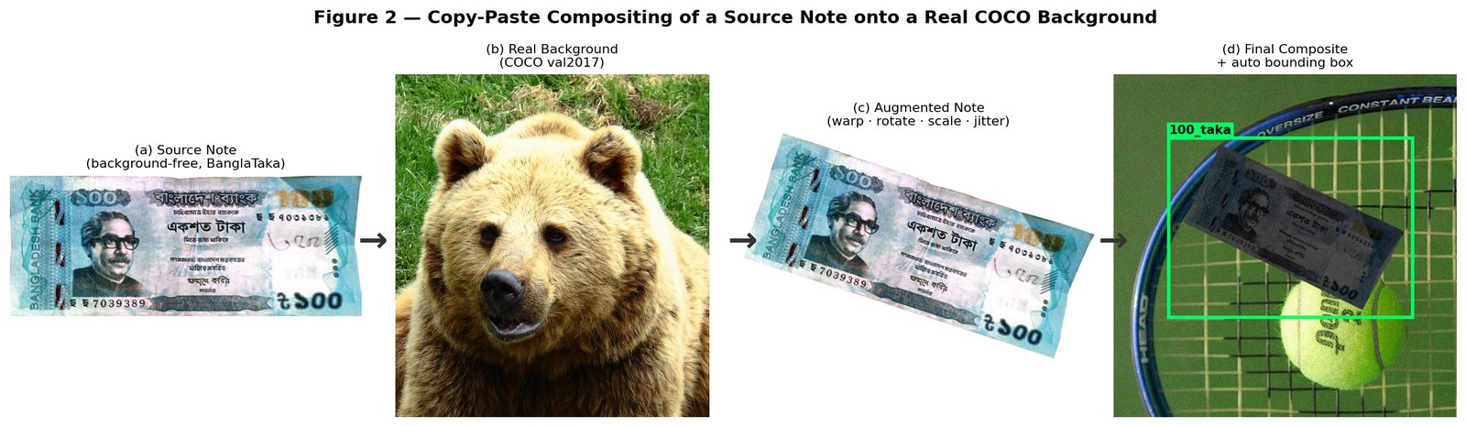
Taka detection: 22,333 training images, no hand labels
0.995
mAP@0.5 on 2,282 held-out composites
91.5%
5,073 note photos are pasted onto real COCO pictures with random angle, scale, light and blur. The program writes the box labels itself.
correct on 1,536 photos taken by others
18.5%
on hand-held close-ups: still a weak point
Notes:
Public Taka images are clean close-ups, so a model trained on them fails on a live camera. We pasted the notes onto real photographs and let the program write the labels. The detector scores 0.995 mAP on held-out composites and names 91.5 percent of independent photographs correctly, but only 18.5 percent of hand-held close-ups.

Slide 9
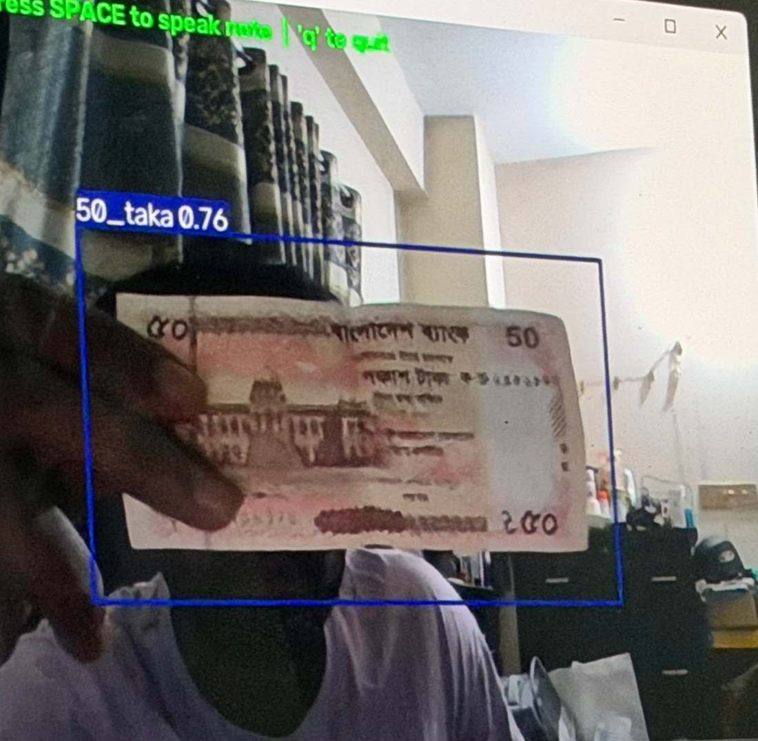
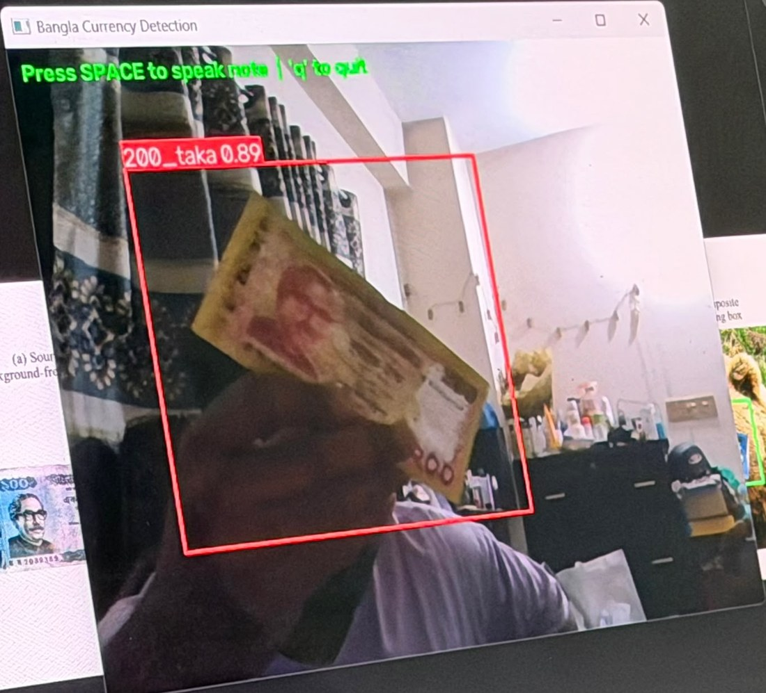
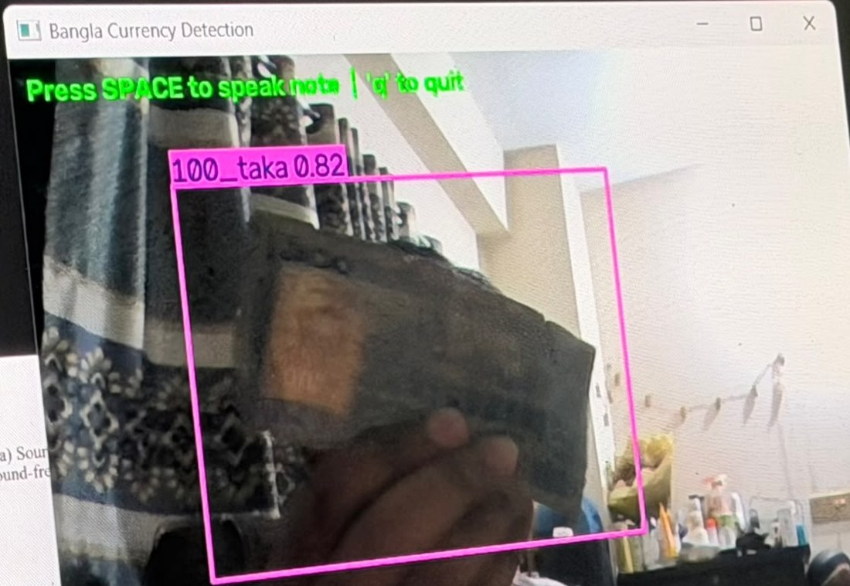
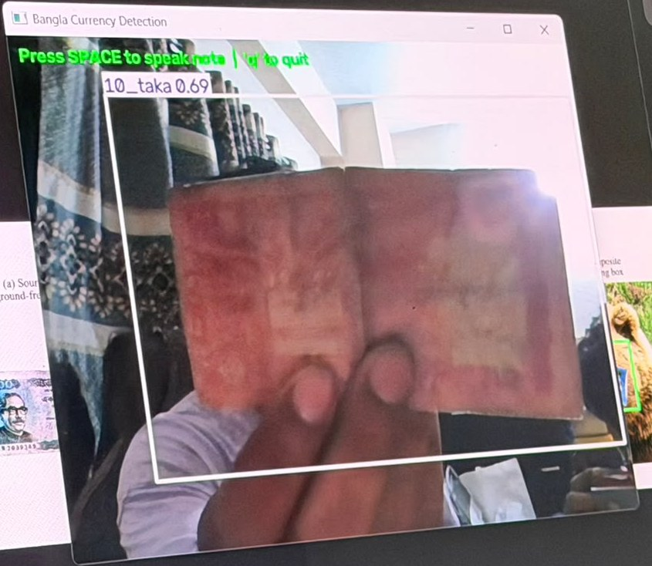
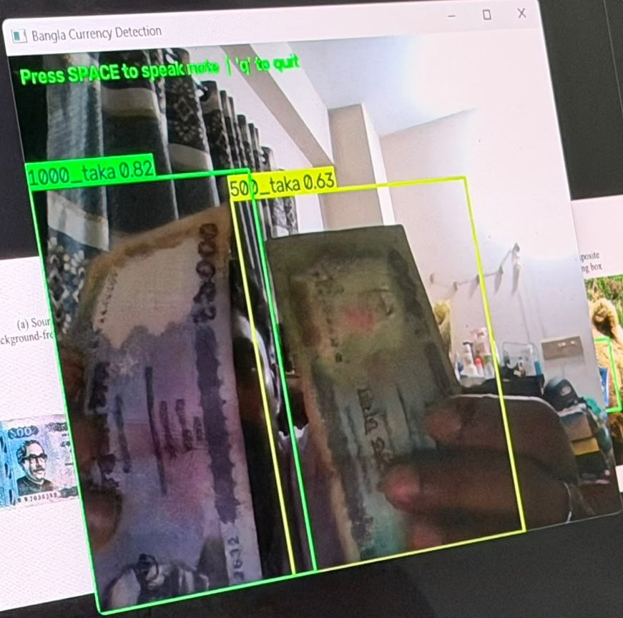
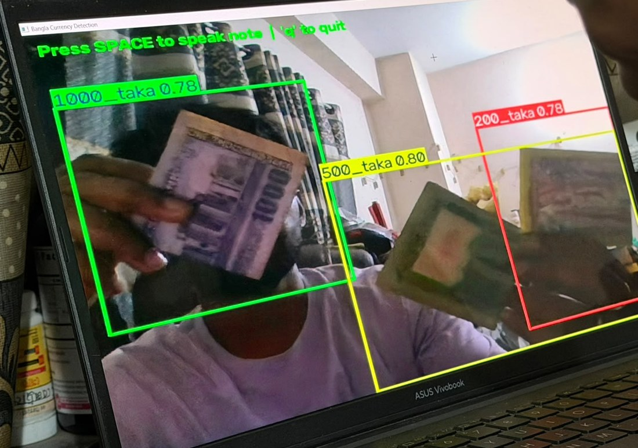
Live test with real notes
10, 50, 100, 200, 500 and 1,000 Taka named at 0.63–0.89 confidence
Works on worn and folded notes and with two or three notes at once
Boxes are loose and can overlap when notes are close
Informal sessions with a laptop webcam; no error rate was counted.
Notes:
Here the detector runs live on a laptop webcam with our own notes, including worn and folded ones. These are illustrations, not a measurement: we did not count an error rate in these sessions.

Slide 10
Counterfeit check: one view is enough with prefix training
71.2% → 98.2%
accuracy with a single view, JaalTaka, 3 seeds
A blind user cannot promise six views
Training on random first-k views removes the collapse
No loss at six views; stable across seeds
Notes:
A model trained only with all six views of a note collapses when it sees one view: 71 percent. Training on random prefixes of the views keeps it at about 98 percent from one to six views. The controlled experiment shows prefix sampling alone is responsible.

Slide 11
Unseen counterfeit prints: the honest test
279 of 322
readable 500 Taka counterfeits carry the same serial number
The usual split puts copies of one print in training and test. A serial lookup alone scores 90.2%. We built a split where every test counterfeit is a new print.
The watermark brings accuracy back to 95%, level with a fine-tuned ResNet-50. With about 24 test prints we claim a tie, not a win.
Notes:
We found that most counterfeit notes in JaalTaka are copies of a few prints, so the usual test measures recognition of known reprints. On truly unseen prints our network drops from about 98 to about 89 percent. Adding the banknote watermark, located by a small learned model, brings it to 95 percent, the same as a properly fine-tuned ResNet-50.

Slide 12

Safe before decisive: the glass never says "counterfeit"
"Likely genuine"
yes
0 / 88
Score above threshold?
"Check by hand"
no
test counterfeits passed as "likely genuine"
Threshold = highest score of any validation counterfeit, so a new counterfeit passes with probability 1/(n+1) = 1.1%.
The price of safety
On close-up views 57.5% of genuine notes are confirmed, but on whole-note photos only 0.4–2%. Most notes go to "check by hand".
Notes:
Because a blind user cannot verify the answer, the glass never says a note is counterfeit. It says likely genuine only above a threshold set from validation data, otherwise it asks for a check by hand. No test counterfeit passed. The honest cost is that on whole-note photos it almost always asks for a hand check.

Slide 13
Bangla reading: error cut by three quarters
What helped
Reading only the main block of text
Tuned detector settings, CLAHE
Simple clean-up rules
What did not
Binarisation, multi-scale reading
Tesseract, TrOCR, PaddleOCR
Dictionaries and language models
Benchmark with correctly shaped Bangla; every choice made on validation data.
Notes:
We built a test set with correctly shaped Bangla and separate phrases and fonts for validation and test. The biggest gain came from reading only the main block of text and ignoring background text. Overall error fell from 9.3 to 2.4 percent, Bangla from 11.9 to 3.2.

Slide 14



Running on the Raspberry Pi 5
327 ms
50 ms
207 ms
currency check, median
watermark check
object scan
18.7 s
77.1 °C
1.48 GB
text reading: too slow
peak, no throttling in 30 min
peak memory
Notes:
Measured on a Raspberry Pi 5 with 8 GB. The currency check takes about a third of a second, and with the spoken answer under three seconds. It ran 30 minutes with no thermal throttling. Text reading takes about 19 seconds, which is our clearest speed problem.

Slide 15
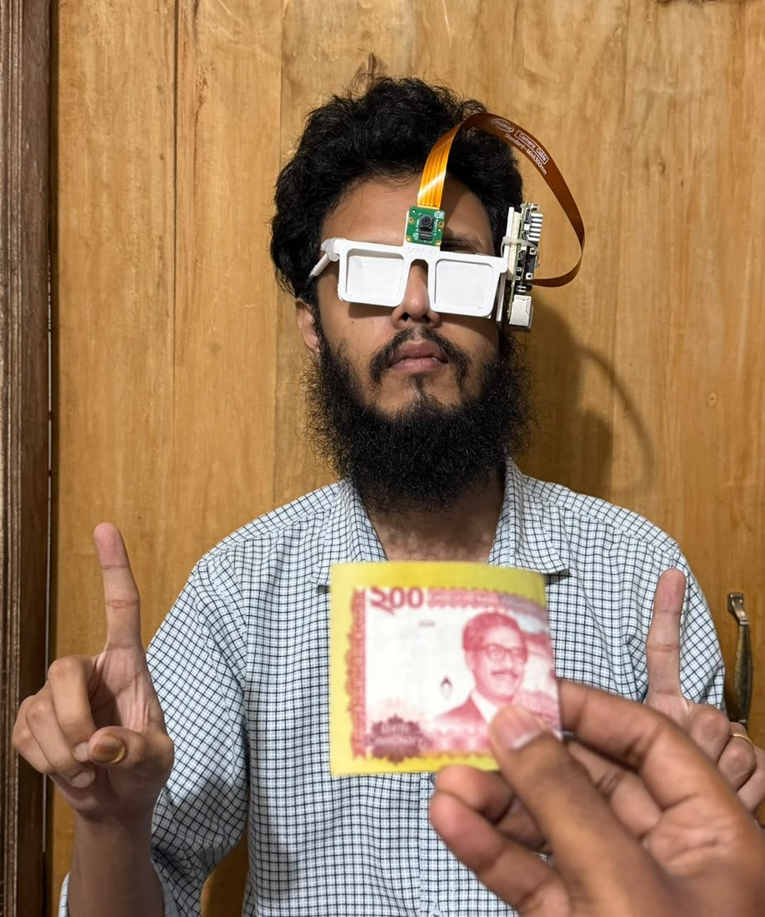

Testing the worn glass
First field test
With the glass camera, currency was unreliable and Bangla text was not read. We suspect the 640×480 fixed-focus picture; the laptop webcam works.
Trials and survey
Sessions with a visually impaired participant have started. A Bangla voice questionnaire records answers; results will follow.
Notes:
The laboratory numbers do not yet describe the worn glass. In the first field test with the glass camera, currency recognition was unreliable and Bangla text was not read. We suspect the low-resolution fixed-focus camera, because the same software works with a laptop webcam. User trials have started and we will add the survey results.

Slide 16


Limitations we report openly
Glass camera
User study
Lab results not yet reproduced on the worn device
Trials started; no results reported yet
Few counterfeit prints
Slow OCR on the Pi
About 24 unseen prints: ±12 points uncertainty
About 19 s per capture
Close-ups and unknown notes
Battery life
18.5% on hand-held close-ups
Not measured yet
Notes:
We report what does not work yet: the worn camera, the user study, the small number of counterfeit prints, slow OCR on the Pi, close-up notes and battery life.

Slide 17
Next steps
1
2
3
4
5
Fix the glass camera
Run the user study
Collect more prints
Faster reading
Pocket enclosure
Higher resolution or autofocus; test set taken through the glass
8–12 participants: task time, accuracy, SUS and NASA-TLX
About 100 unseen counterfeit prints with a bank or the police
Lighter text detector; fine-tune on real photos
Move board, buttons and battery off the frame; measure battery
Notes:
First we fix the camera problem, because it decides whether the lab results hold on the glass. Then the user study, more counterfeit prints, faster reading and a lighter frame with a pocket enclosure.

Slide 18
Thank you
Questions are welcome
A Bangla-first glass that reads, names objects and recognises Taka on a Raspberry Pi 5
Honest tests: unseen prints, a safe verdict, correctly shaped Bangla
Next: make it work through the glass camera and with users
Notes:
To sum up: we built a Bangla-first assistive glass that runs on a Raspberry Pi 5, tested it honestly, and found both what works and what does not yet. Thank you. We are happy to take questions.

